Slide 1
Department of Applied Mathematics and Computational Sciences
III Sem M.Sc.Software Systems
Transform Techniques
Dr. V. Suresh kumar

Slide 2
Shifting Theorem

Slide 3
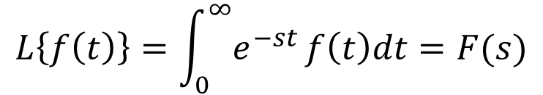

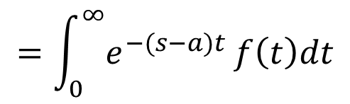
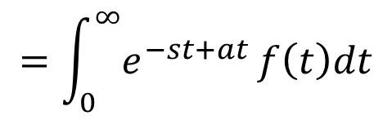
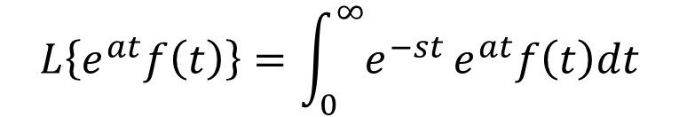
Statement
If $L\left\{f\left(t\right)\right\}=F(s)$ then $L\left\{e^{at}f\left(t\right)\right\}=F(s−a)$
Proof:
We have
$$L\left\{f\left(t\right)\right\}=\int_{0}^{∞}{e^{−st}}f\left(t\right)dt=F(s)$$
$$L\left\{e^{at}f\left(t\right)\right\}=\int_{0}^{∞}{e^{−st}}e^{at}f\left(t\right)dt$$
$$=\int_{0}^{∞}{e^{−st+at}}f\left(t\right)dt$$
$$=\int_{0}^{∞}{e^{−(s−a)t}}f\left(t\right)dt$$
$$=F(s−a)$$

Slide 4







Note
$L\left\{f\left(t\right)\right\}=F(s)$
$$L^{−1}\left[F\left(s\right)\right]=f\left(t\right)$$
$$L\left\{e^{at}f\left(t\right)\right\}=F(s−a)$$
$$L^{−1}\left[F\left(s−a\right)\right]=e^{at}f\left(t\right)$$
$$L^{−1}\left[F\left(s−a\right)\right]=e^{at}L^{−1}\left[F\left(s\right)\right]$$
$$L\left\{e^{−at}f\left(t\right)\right\}=F(s+a)$$
$$L^{−1}\left[F\left(s+a\right)\right]=e^{−at}L^{−1}\left[F\left(s\right)\right]$$

Slide 5
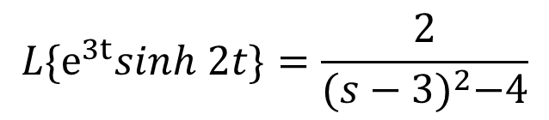
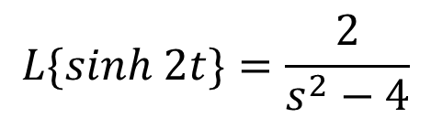


Example Problems
1. Find the Laplace Transform of $e^{3t}sinh 2t$
Ans:
$$f(t)$$
$$F(s)$$
We have
$$L\{sinh 2t\}=\frac{2}{s^{2}−4}$$
$$L\{e^{3t}sinh 2t\}=\frac{2}{{(s−3)}^{2}−4}$$

Slide 6
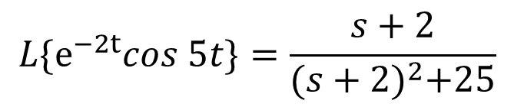
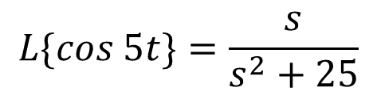
Problems cont…
2. Find the Laplace Transform of $e^{−2t}cos 5t$
Ans:
We have
$$L\{cos 5t\}=\frac{s}{s^{2}+25}$$
$$L\{e^{−2t}cos 5t\}=\frac{s+2}{{(s+2)}^{2}+25}$$

Slide 7

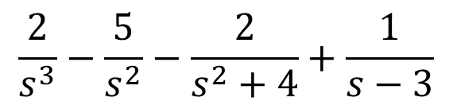
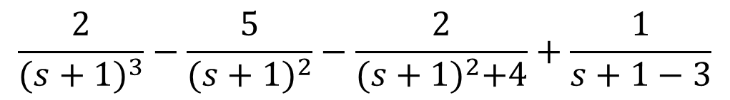
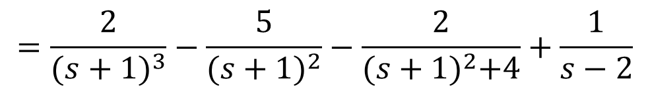

Problems cont…
3. Find the Laplace Transform of $e^{−t}(t^{2}−5t−\sin{2t+e^{3t})}$
Ans:
We have
$$L\left\{t^{2}−5t−\sin{2t+e^{3t}}\right\}=$$
$$\frac{2}{s^{3}}−\frac{5}{s^{2}}−\frac{2}{s^{2}+4}+\frac{1}{s−3}$$
$$\frac{2}{{(s+1)}^{3}}−\frac{5}{{(s+1)}^{2}}−\frac{2}{{(s+1)}^{2}+4}+\frac{1}{s+1−3}$$
$$L\{e^{−t}(t^{2}−5t−\sin{2t+e^{3t})}\}=$$
$$=\frac{2}{{(s+1)}^{3}}−\frac{5}{{(s+1)}^{2}}−\frac{2}{{(s+1)}^{2}+4}+\frac{1}{s−2}$$

Slide 8
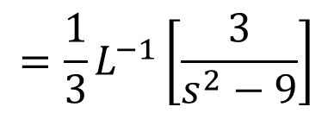
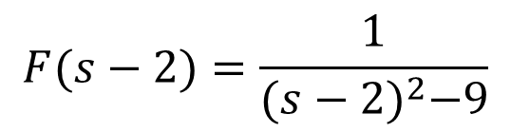
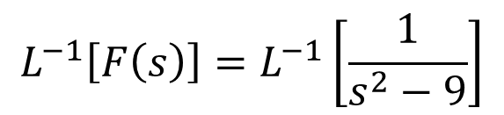

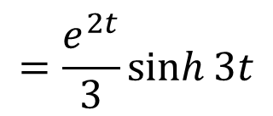
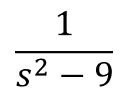
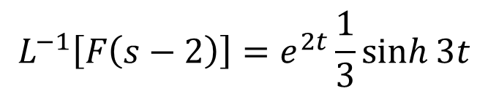

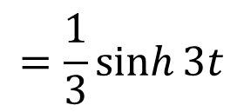
4. Find the Inverse Laplace Transform of $\frac{1}{{(s−2)}^{2}−9}$
Problems cont…
Ans:
$$L^{−1}\left[F\left(s\right)\right]=L^{−1}\left[\frac{1}{s^{2}−9}\right]$$
Take
$$F(s−2)=\frac{1}{{(s−2)}^{2}−9}$$
$$=\frac{1}{3}L^{−1}\left[\frac{3}{s^{2}−9}\right]$$
$$F(s)=$$
$$\frac{1}{s^{2}−9}$$
$$=\frac{1}{3}\sinh{3t}$$
We have
$$L^{−1}\left[F\left(s−2\right)\right]=e^{2t}\frac{1}{3}\sinh{3t}$$
$$L^{−1}\left[F\left(s−2\right)\right]=e^{2t}L^{−1}\left[F\left(s\right)\right]$$
$$=\frac{e^{2t}}{3}\sinh{3t}$$

Slide 9


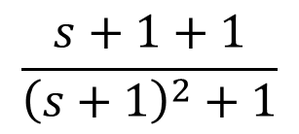
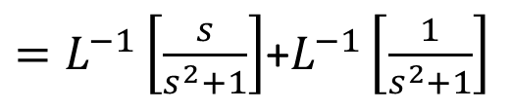
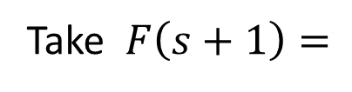
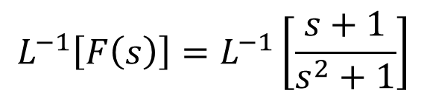
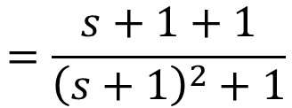


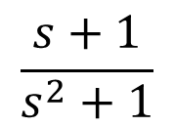

Problems cont…
5.
$$\frac{s+1}{s^{2}+1}$$
Ans:
$$F\left(s\right)=$$
Given
$$L^{−1}\left[F\left(s+1\right)\right]=e^{−t}L^{−1}\left[F\left(s\right)\right]$$
$$L^{−1}\left[F\left(s\right)\right]=L^{−1}\left[\frac{s+1}{s^{2}+1}\right]$$
$=L^{−1}\left[\frac{s}{s^{2}+1}\right]$+$L^{−1}\left[\frac{1}{s^{2}+1}\right]$
$$=\frac{s+1+1}{{\left(s+1\right)}^{2}+1}$$
$$=\cos{t+\sin{t}}$$
$$\frac{s+1+1}{{\left(s+1\right)}^{2}+1}$$
$$L^{−1}\left[F\left(s+1\right)\right]=$$
$$e^{−t}\left(\cos{t+\sin{t}}\right)$$
Take $F\left(s+1\right)=$

Slide 10
Homework Problems
Find the Inverse Laplace Transform for the following

Slide 11


